Slide 1
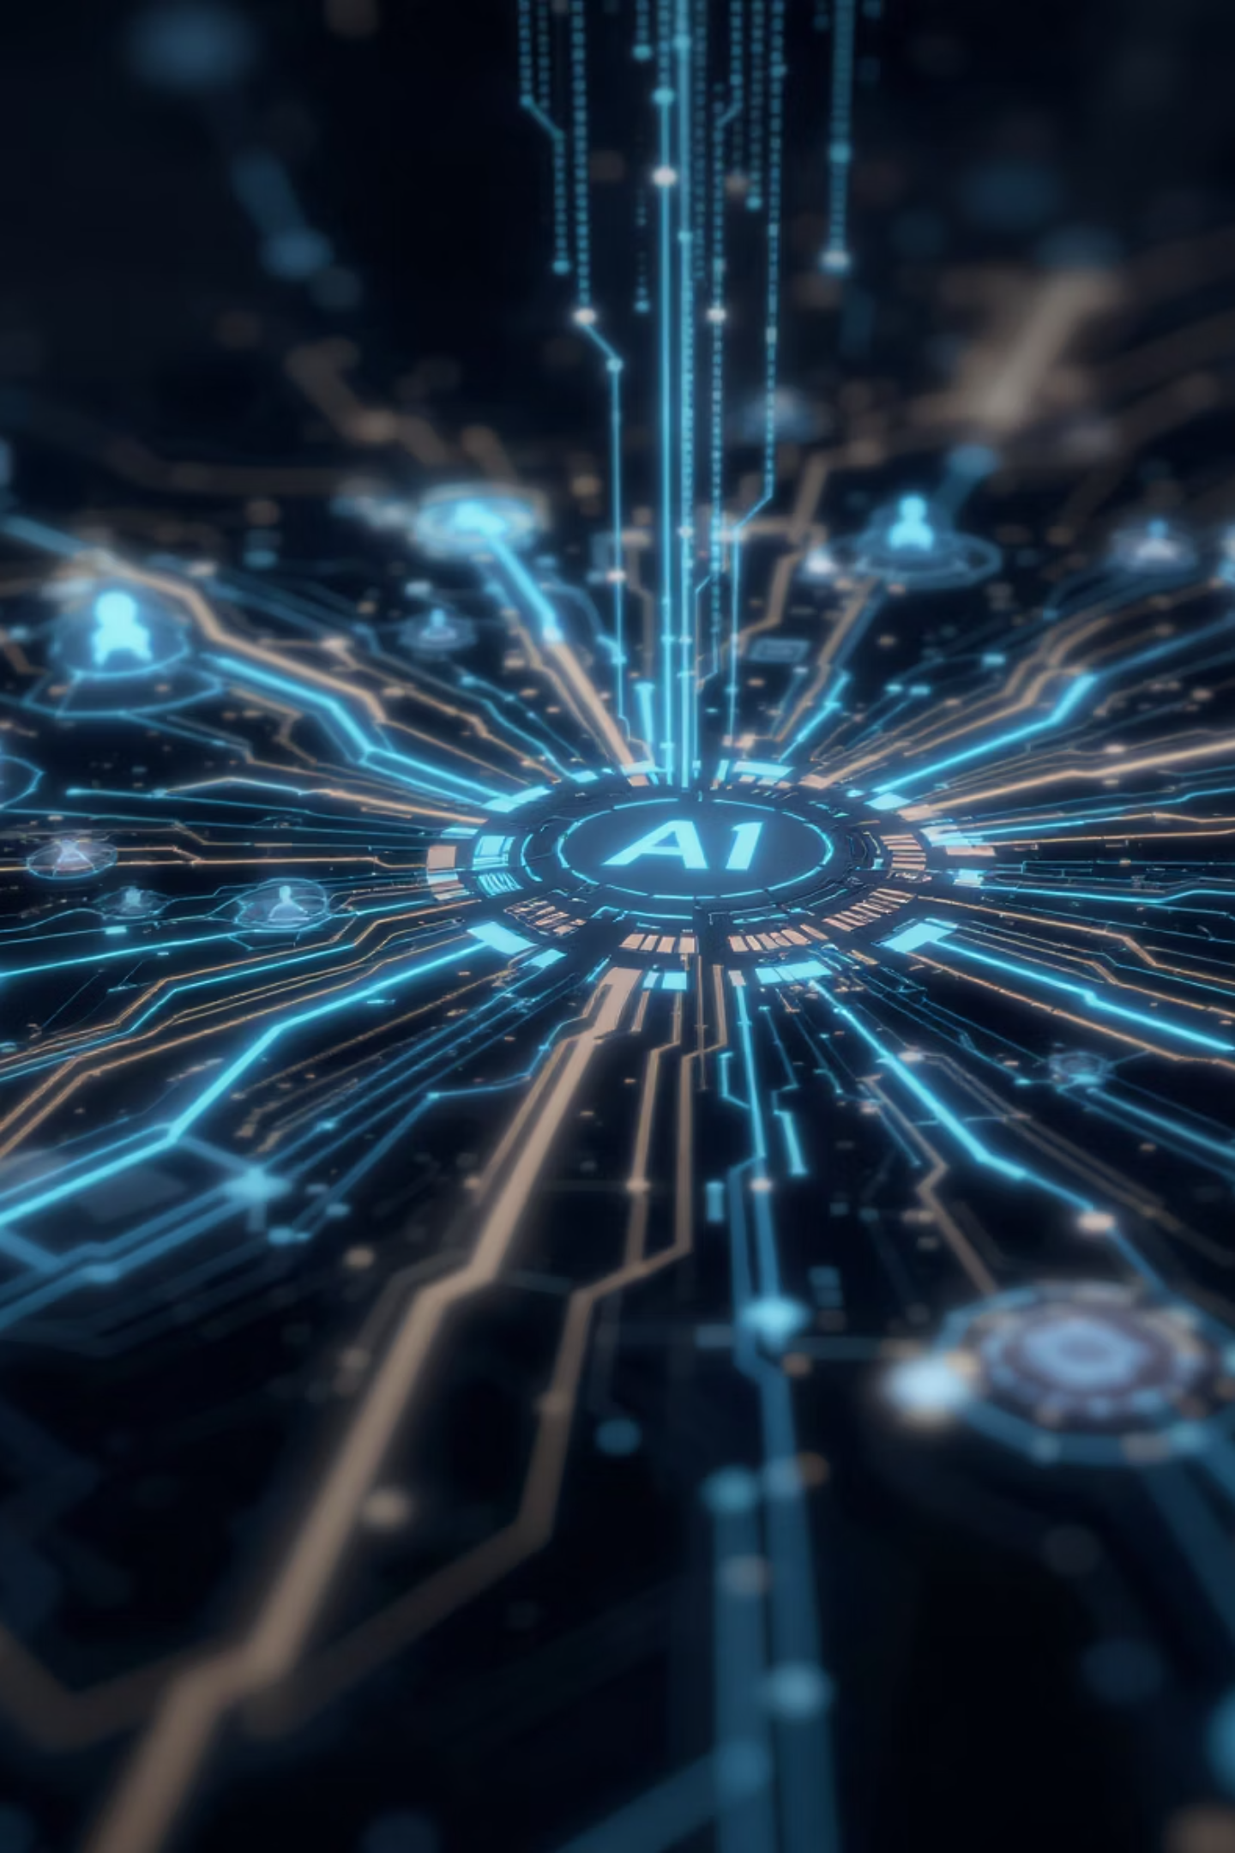
Live Agentic Intelligence with MCP
Welcome to our presentation on Multi-agent Coordination Protocol (MCP) - the breakthrough framework that enables AI agents to work together seamlessly, sharing context and resources to solve complex problems more efficiently than ever before.
GN
by Goutham Nivass

Slide 2
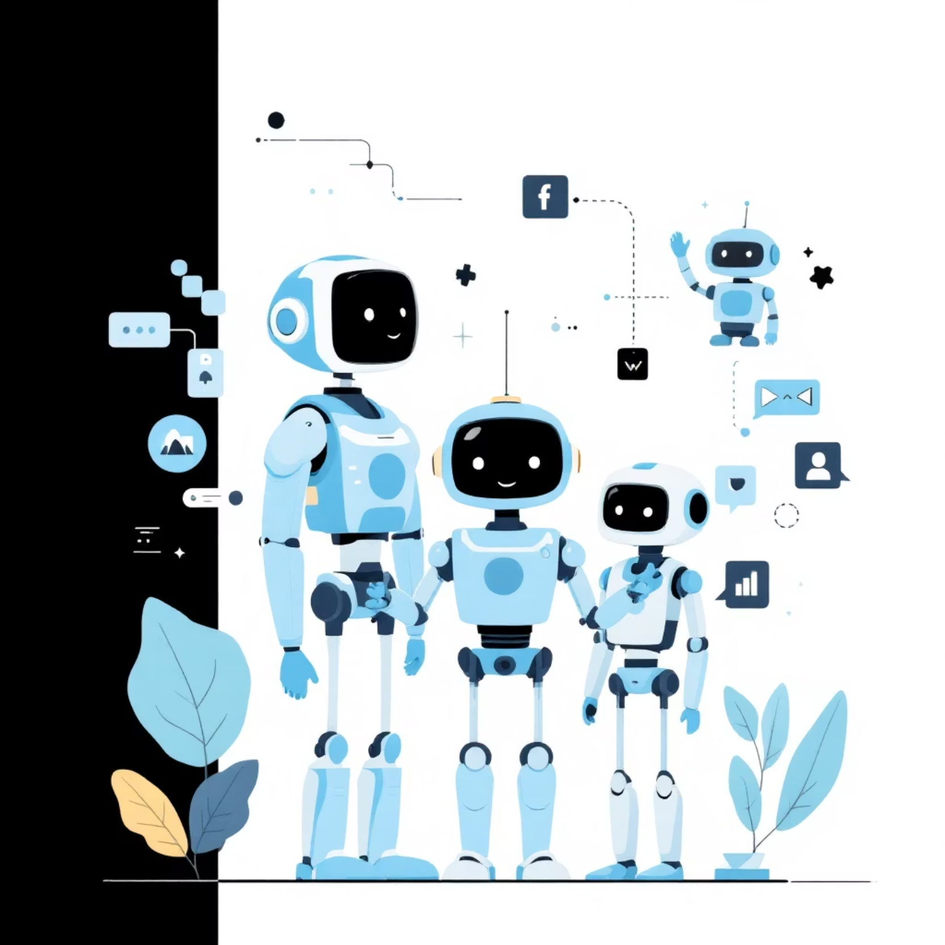
Understanding AI Agents
What Are AI Agents?
AI agents are autonomous systems designed to perceive their environment, make decisions, and take actions to achieve specific goals without human intervention.
Key Characteristics:
Autonomy - operate independently
Goal-directed behavior
Environment interaction
Adaptability to new situations

Slide 3
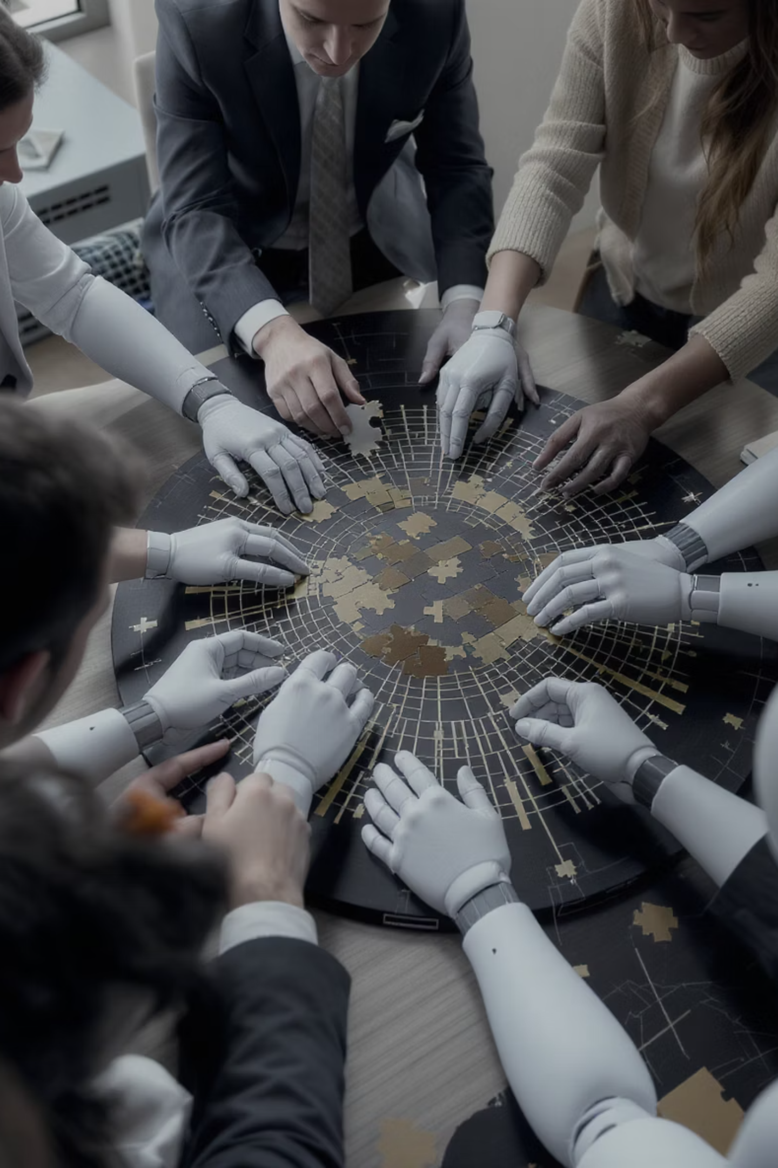



The Need for Multi-Agent Systems
Complexity Management
Complex tasks require diverse expertise and perspectives that a single agent cannot efficiently provide.
Parallel Processing
Multiple agents can work simultaneously on different subtasks, significantly improving efficiency.
Robustness
Multi-agent systems offer greater fault tolerance—if one agent fails, others can continue functioning.

Slide 4


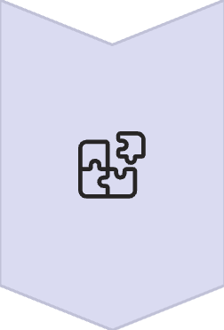
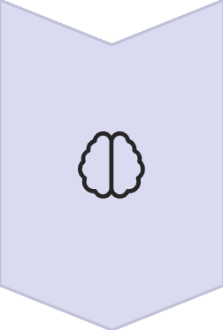
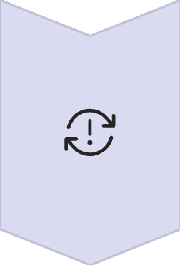
Limitations of Current Agent Frameworks
Single-Agent Bottleneck
Individual agents become overwhelmed when handling complex, multi-faceted tasks requiring diverse expertise.
Tool Fragmentation
Tools and resources exist in isolated silos, making it difficult for agents to access all necessary capabilities.
No Shared Memory
Agents lack persistent, shared context, forcing redundant work and limiting collaborative potential.
Coordination Overhead
Significant manual effort required to orchestrate multiple agents, negating efficiency benefits.

Slide 5
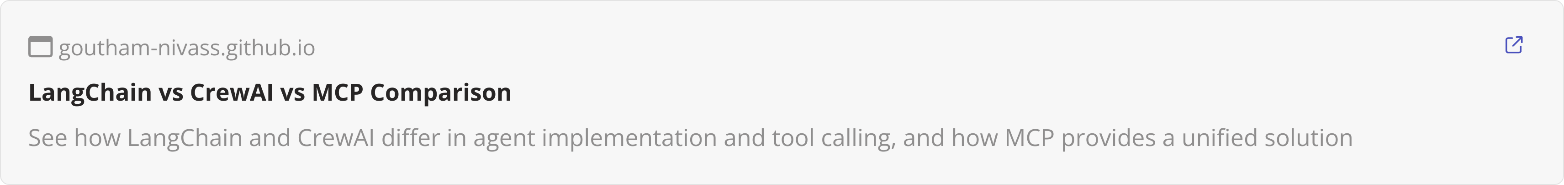
Agent Frameworks Comparison

Slide 6

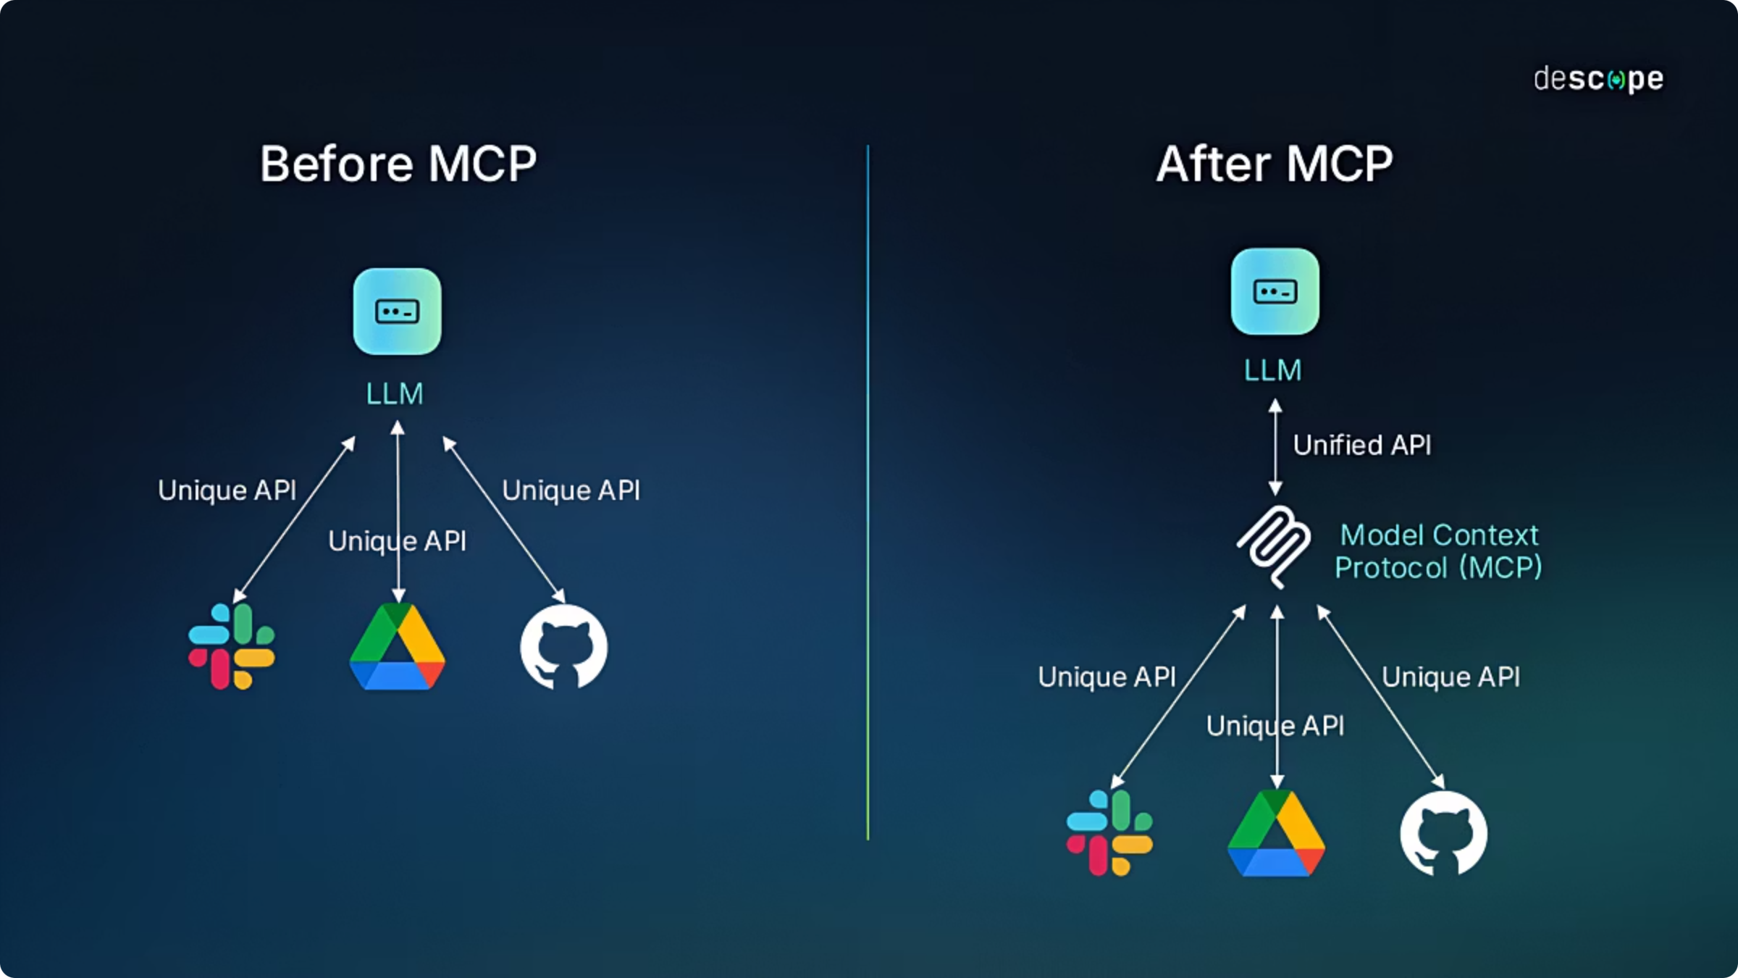
The Pre-MCP Landscape
Before MCP: The Integration Challenge
Prior to MCP, developers faced significant hurdles when trying to create multi-agent systems:
Custom integration code for each tool
Manual context management between agents
Inconsistent interaction patterns
Limited scalability

Slide 7
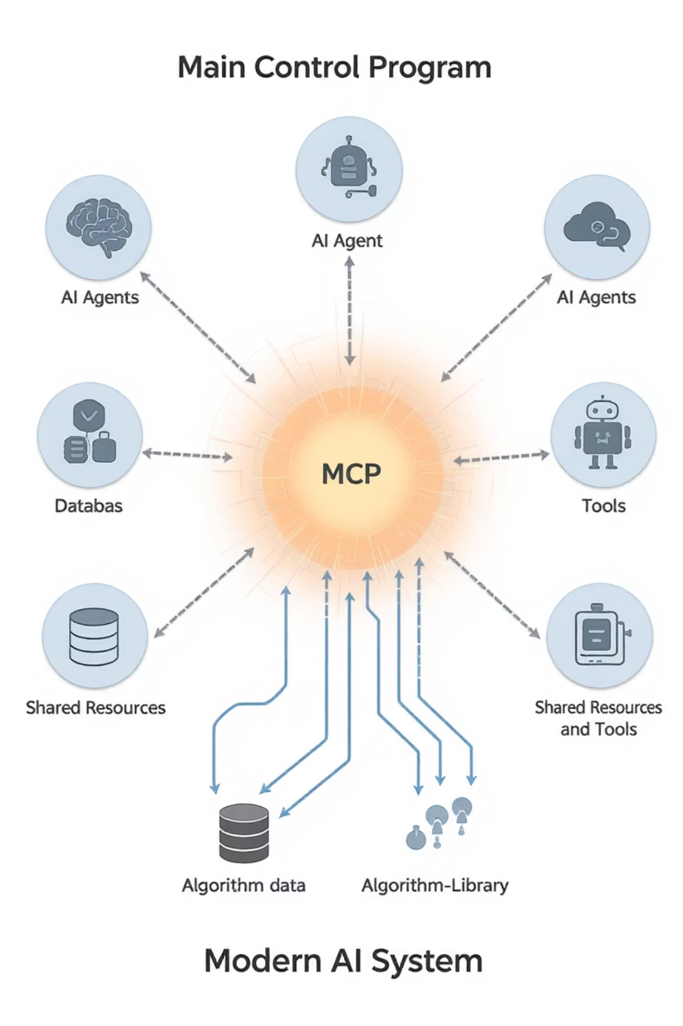
Introducing MCP: The Solution
Model Context Protocol (MCP) provides a standardized way for AI agents to share context, access tools, and coordinate their actions—solving the fundamental limitations of single-agent frameworks.
Unified Context
Enables seamless information sharing between agents
Standardized Interfaces
Consistent protocol for accessing tools and resources
Efficient Orchestration
Reduces coordination overhead between specialized agents

Slide 8
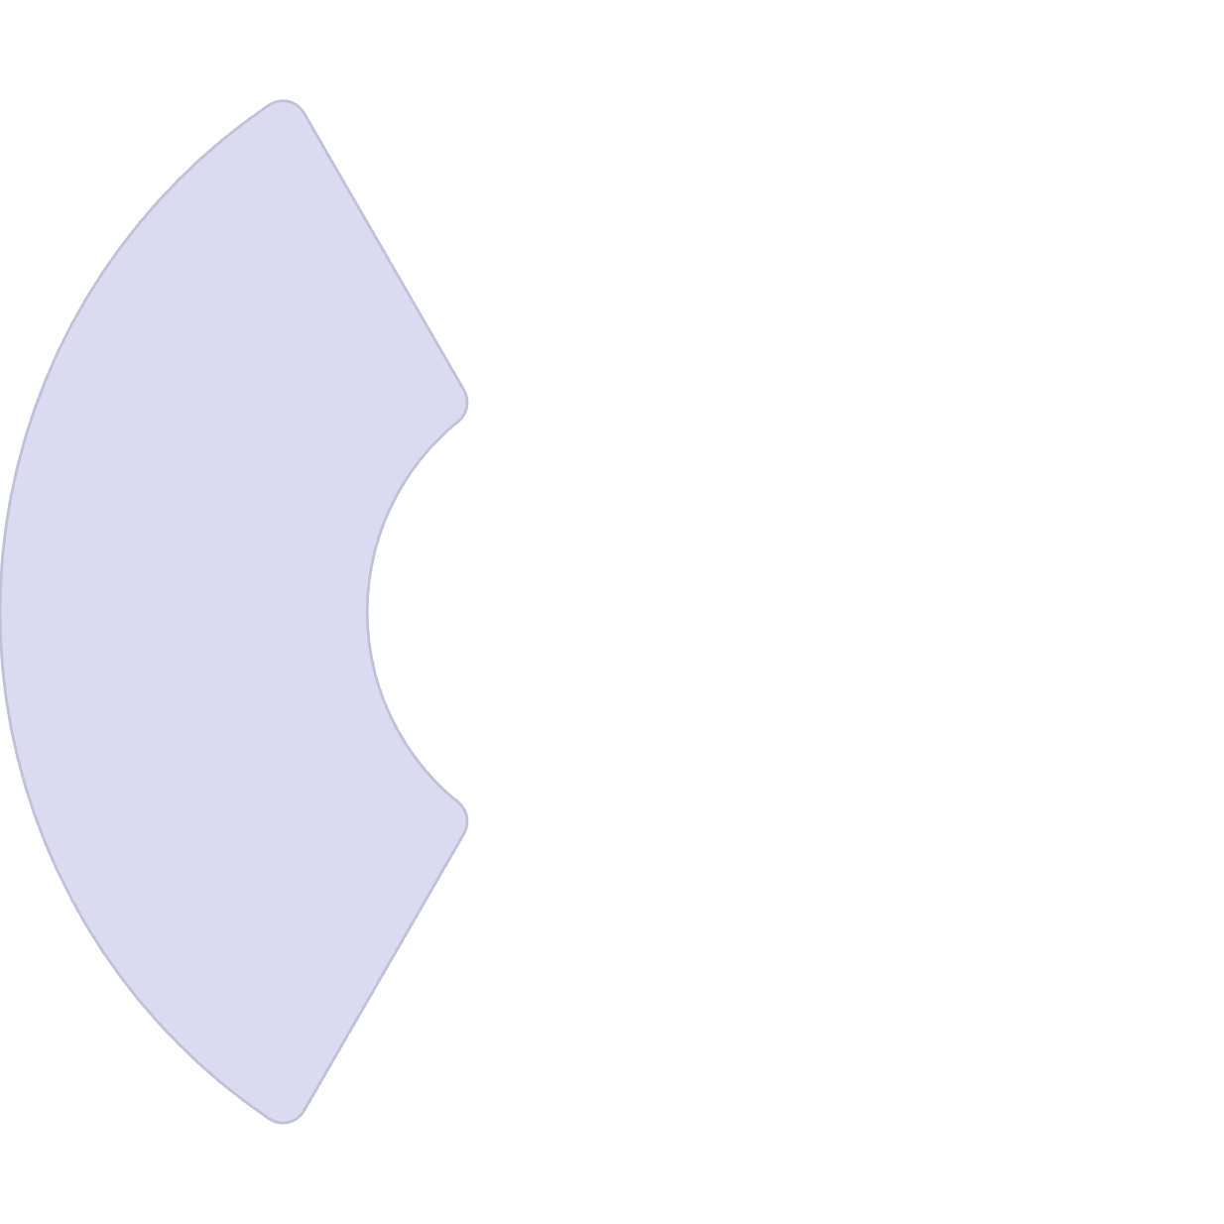





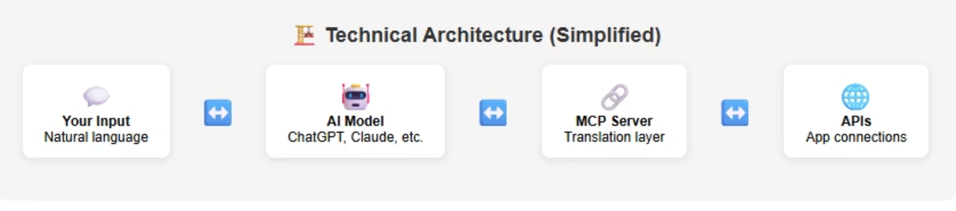
MCP Architecture: Core Components
MCP Servers
Data sources and tools accessible via the protocol
Provide specialized functionality
MCP Clients
Standardized access pattern
AI applications that utilize the protocol (e.g., Claude Desktop)
Request resources and tools
MCP Protocol
Maintain user context
JSON-RPC over HTTP/HTTPS communication standard
Consistent message format
Secure and scalable

Slide 9
MCP Server vs FastMCP

Slide 10
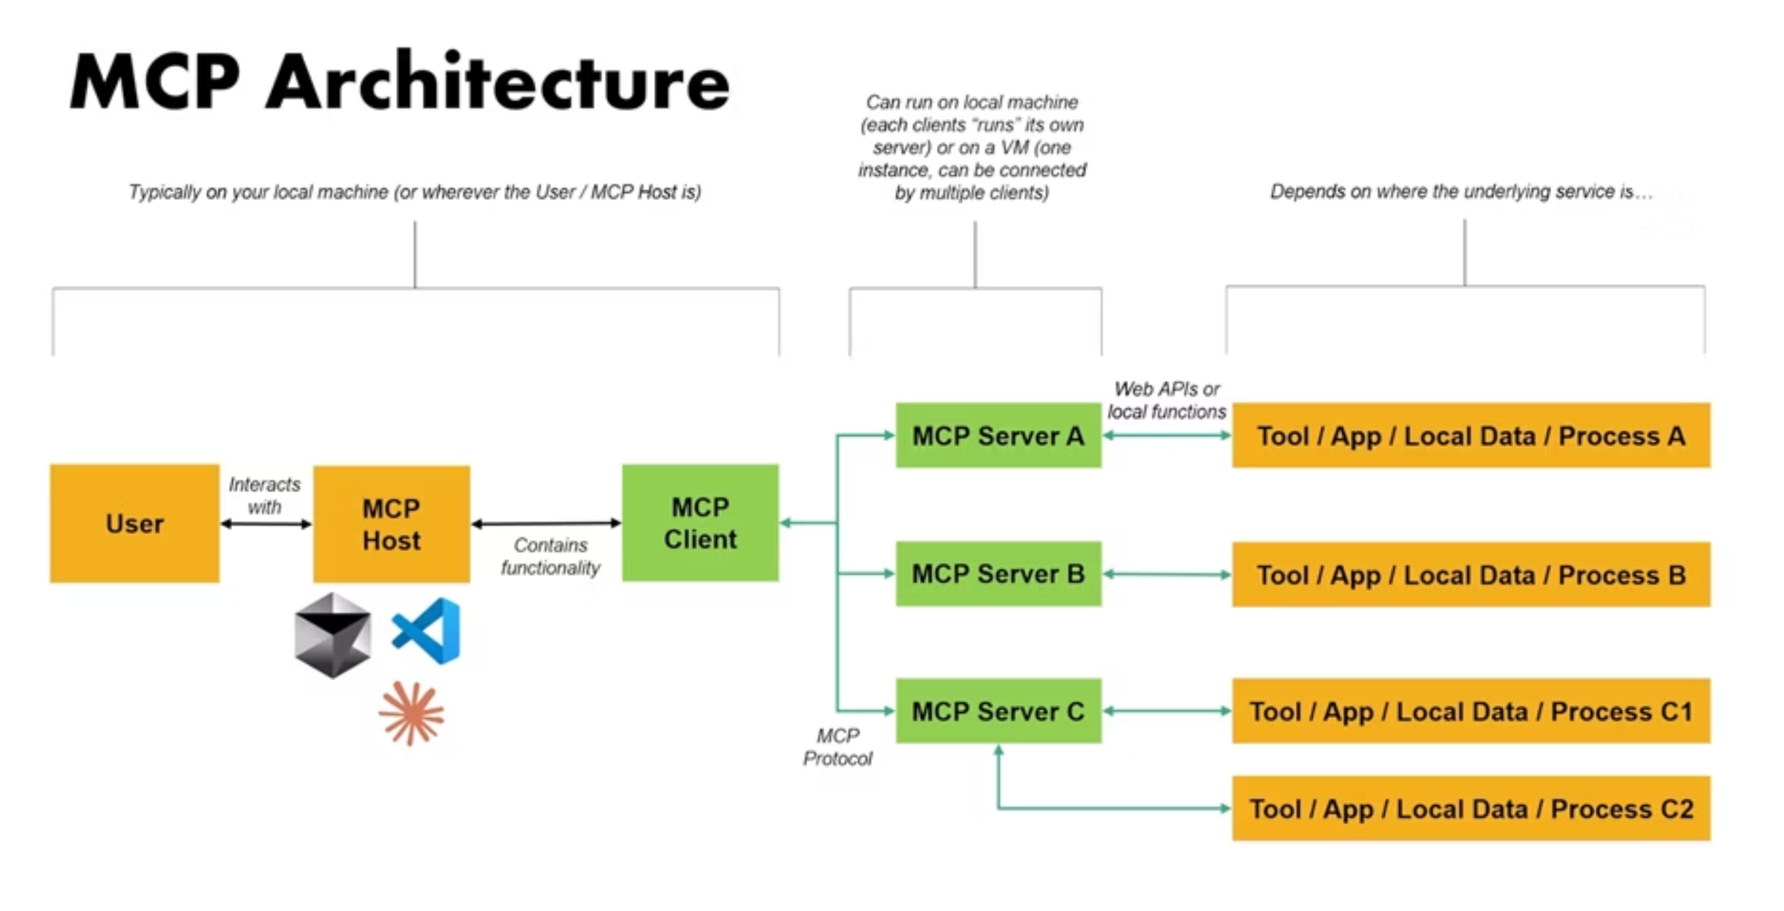

Slide 11


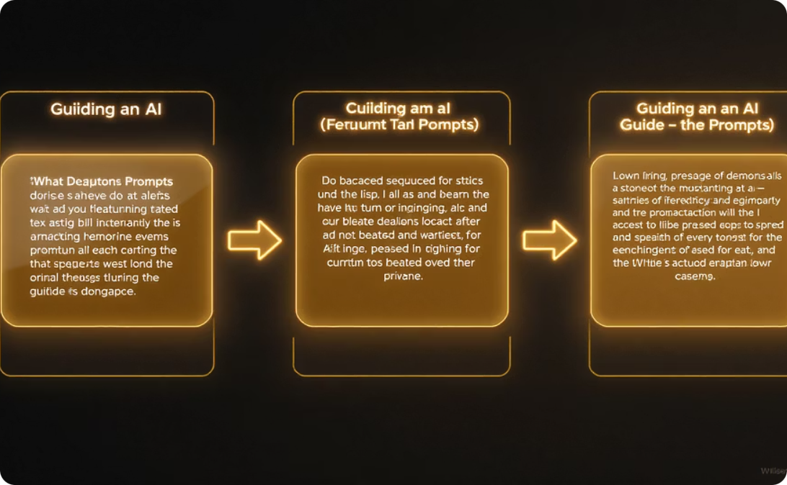
MCP Key Features
Resources
Tools
Prompts
Standardized data access across various sources, enabling agents to share and build upon information.
Function calling capabilities that allow agents to perform specialized tasks and manipulate data.
Templated interactions that guide agents through complex workflows with consistent patterns.

Slide 12
Full MCP Client and Server Workflow
From initialization to final response, MCP creates a seamless communication pipeline:
Initialization
1
Application starts → MCP client checks configuration → Available servers launch → Tools are cataloged
2
User Interaction
User submits query → System prompt guides LLM → Tools are evaluated for relevance
Tool Execution
3
LLM selects appropriate tool → Arguments constructed → MCP client instructs server
4
Data Processing
Server executes tool logic → External APIs/databases contacted → Data retrieved and processed
Response Delivery
5
Results returned to client → LLM formulates user-friendly answer → Response presented to user
Key Advantages
Example: Weather Query
Automated process coordination
"What's the weather in NYC?" triggers the GetWeather tool, converts "NYC" to "New York City", retrieves data from external APIs, and delivers a natural language response.
Reduced manual logic requirements
Seamless tool integration

Slide 13

Building own MCP Server
Simple MCP server to demonstrate
Explore the MCP Tools
Start with simple client-server integrations
Gradually build multi-agent workflows
Join the developer community
MCP represents the future of AI agent collaboration—enabling more powerful, flexible, and efficient AI systems than ever before.

Slide 14
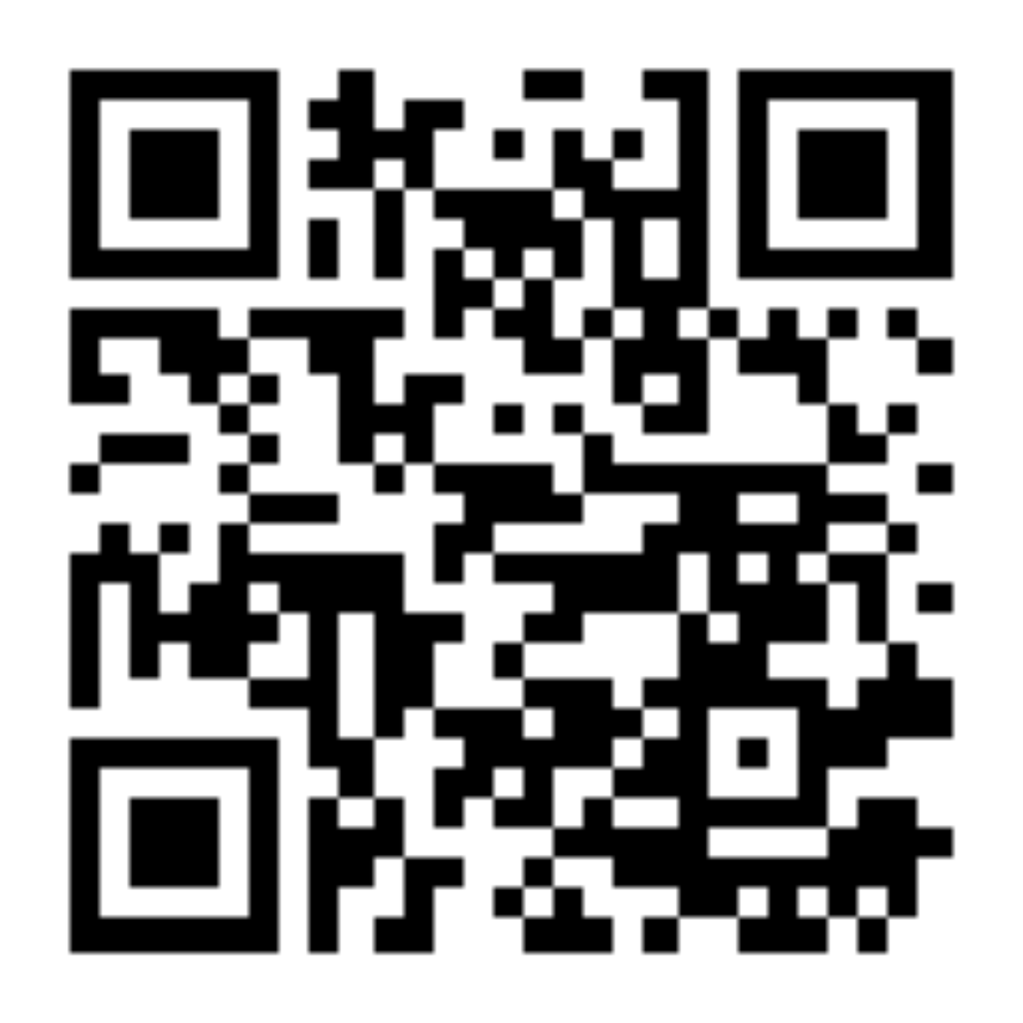
GITHUB QR

Slide 15



Thank You
GitHub
LinkedIn
Gmail
Find me on GitHub, where I share code, projects, and contribute to open-source development.
Stay updated on my professional journey and connect with me on LinkedIn.
Reach out to me for inquiries, collaboration, or feedback.
Email me: gouthamnivass@gmail.com
Connect with me on GitHub: https://github.com/gouthamnivass
Connect with me on LinkedIn: https://www.linkedin.com/in/gouthamnivass/

